Slide 1
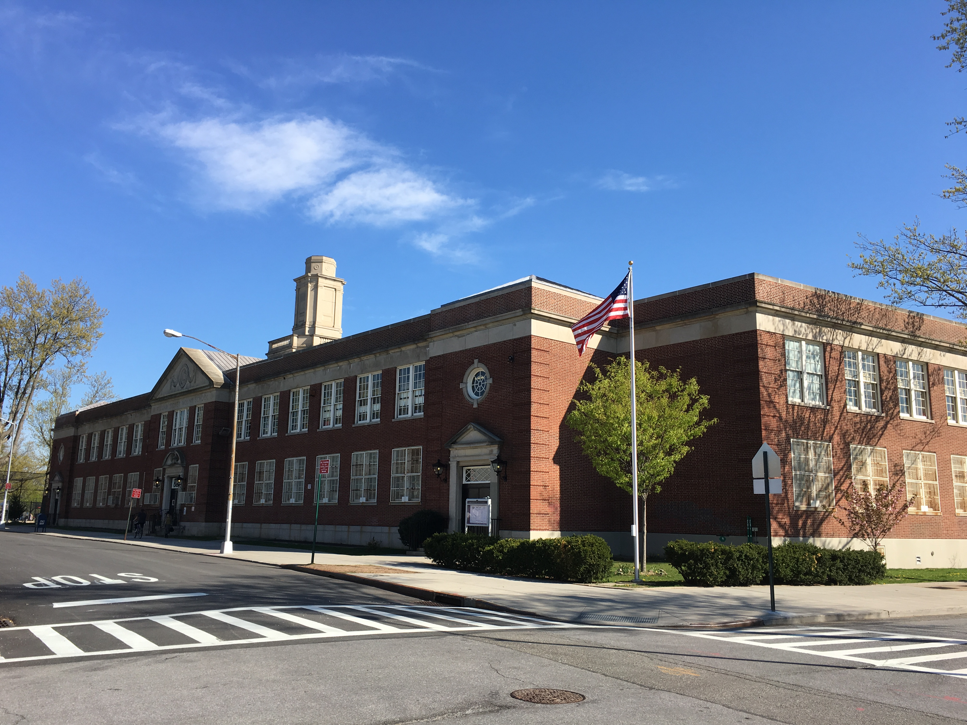
Public School 174 William Sidney Mount
Town Hall
Return to School Fall 2020
Blended Learning
Thursday, August 13, 2020
10am- 11am
Via Google MEET
Karin Kelly, Principal Kerstin Kobetitsch, AP
Laura Hui, Parent Coordinator Wendy Bernstein, Teacher

Slide 2
Blended Learning – In Person
As we return to school in the Fall, instruction for all of our students needs to focus on these key elements:
Begin with Knowing Students Well
Integrate Academic and Social Emotional Learning
Ensure Continuity of Learning
Focus on Priority Learning

Slide 4
Rationale for Model 2
Physical Space - Model 2 was selected as we could not physical support Model 1A or B as class size using this model did not comply with social distancing within number of classrooms in the school.
Safe Distancing - Model 2 will allow for all precautions such as proper social distancing, temperature checks at entry during arrival and movement in the building.
Additional Students – As we move through the year, Model 2 will account for new admits and students who may return to Blended Learning through the year.
***Safety, Safety, Safety***
Safety of our entire school community is the primary concern from our parent engagements, of surveys and staff.

Slide 5
Model Selection Process
School Leadership Engagement – School Leadership Team (staff and parents), PA Parent Leaders, School Safety Team members, including Custodian have been in contact in June, July and August to review and consider:
Social Distancing Capacity Report – Room Square Footage; operable windows
Staffing – Staff have the ability to apply for Accommodations
Physical Space – Entrances/classrooms/hallways/use of large spaces
Class Registers – (from 25-32 students; space can account for 8-10 students)
***Safety, Safety, Safety***
Safety of our entire school community is the primary concern from our parent engagements, of surveys and staff.

Slide 6
Instructional Expectations
Our goal is ensuring every student in PS 174, experiences rigorous instruction in a supportive and affirming learning environment.
Focusing on and creating culturally responsive, student-centered learning environments while developing critical thinking skills, communication and advanced literacy skills.
Blended learning framework combines technology, resources, and flexibility in an effort to personalize instruction while maximizing learning time. There continues to be more digital content and innovative data resources become available.

Slide 7
Opt into 100% Remote Learning online by August 7th. Note: Opt back into Blended Learning at scheduled intervals.TBD (ex November)
Blended Learning
Opt into—
100% Remote at Home anytime.

Slide 8
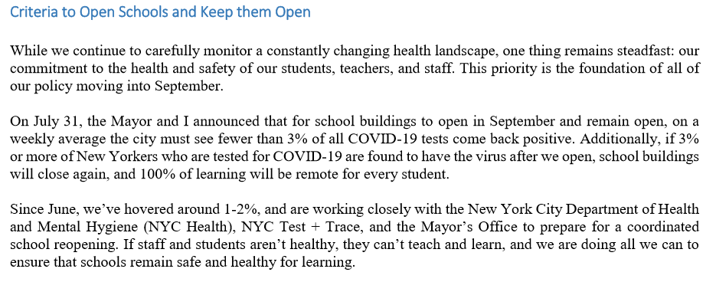
Chancellor Carranza’s Family Letter – August 3, 2020
Health and Safety Protocol

Slide 9
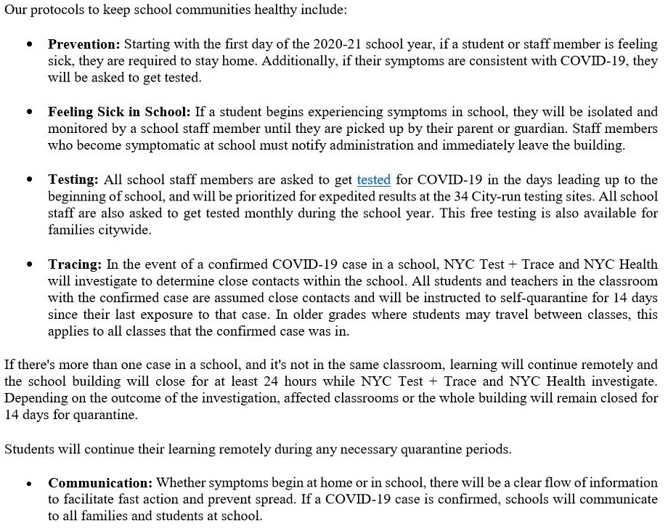

Slide 10
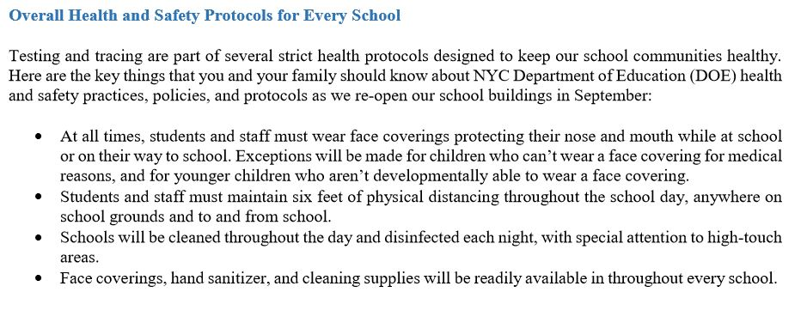

Slide 11
Planning
State Education Department Issues Guidance to Reopen New York State Schools | New York State Education Department The New York State Education Department released guidance to help schools and school districts as they plan to reopen, whether that occurs in person, remotely, or in a combination of the two. The guidance builds on the Framework of Guidance that the Department presented to the Board of Regents on Monday, July 13. “On Monday, the Department presented a comprehensive framework of ... www.nysed.gov Centers for Disease Control and Prevention Issued Re-opening Guidance CDC issued guidance on re-opening for school districts.

Slide 12
Save the date! Register!
NYC Citywide Virtual
Family and Student Return to School Sessions
With Chancellor Carranza
6:30pm- 8pm
Return to School 2020
Want to learn more about NYC schools plans for the 2020–21 school year?
Attend our virtual citywide Information session for students and families—
July 14, 2020
July 28, 2020
August 12, 2020
August 27, 2020 Register now: schools.nyc.gov/returntoschool2020. You can also select your preferred language (English, Spanish or Mandarin) and submit a question.

Slide 13
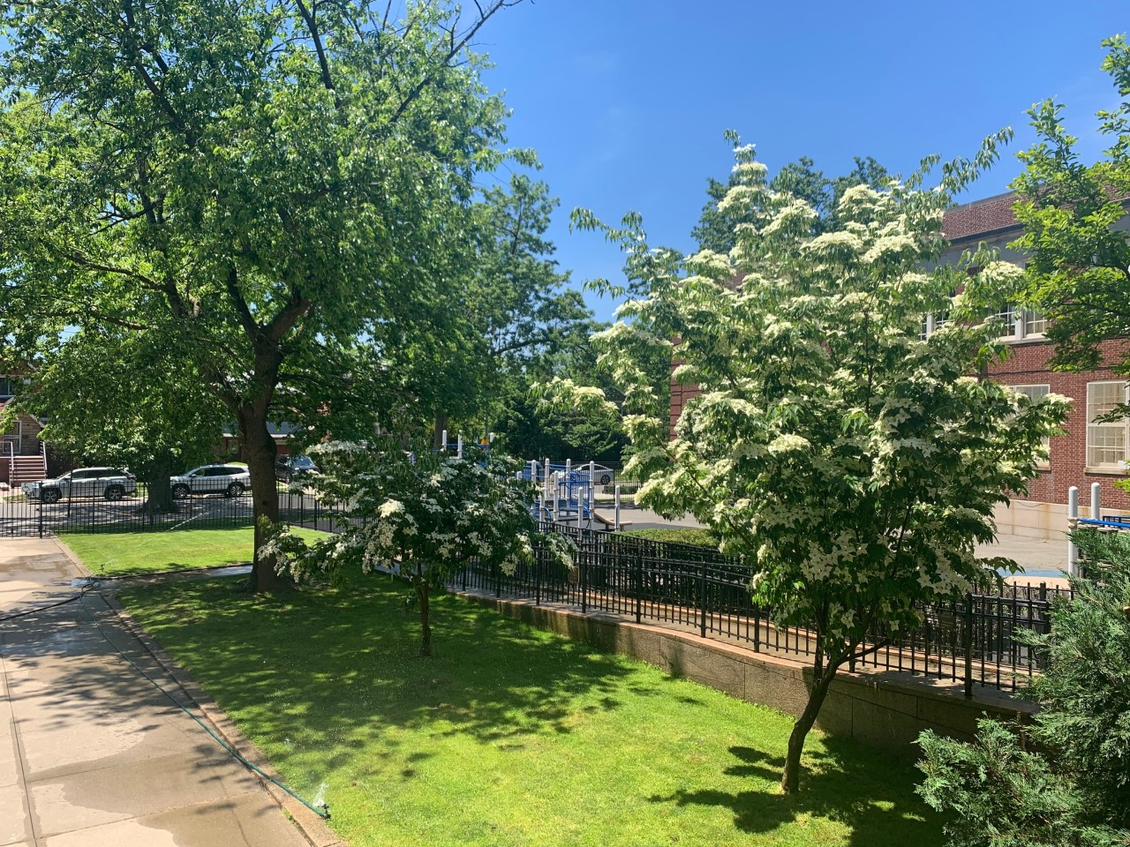
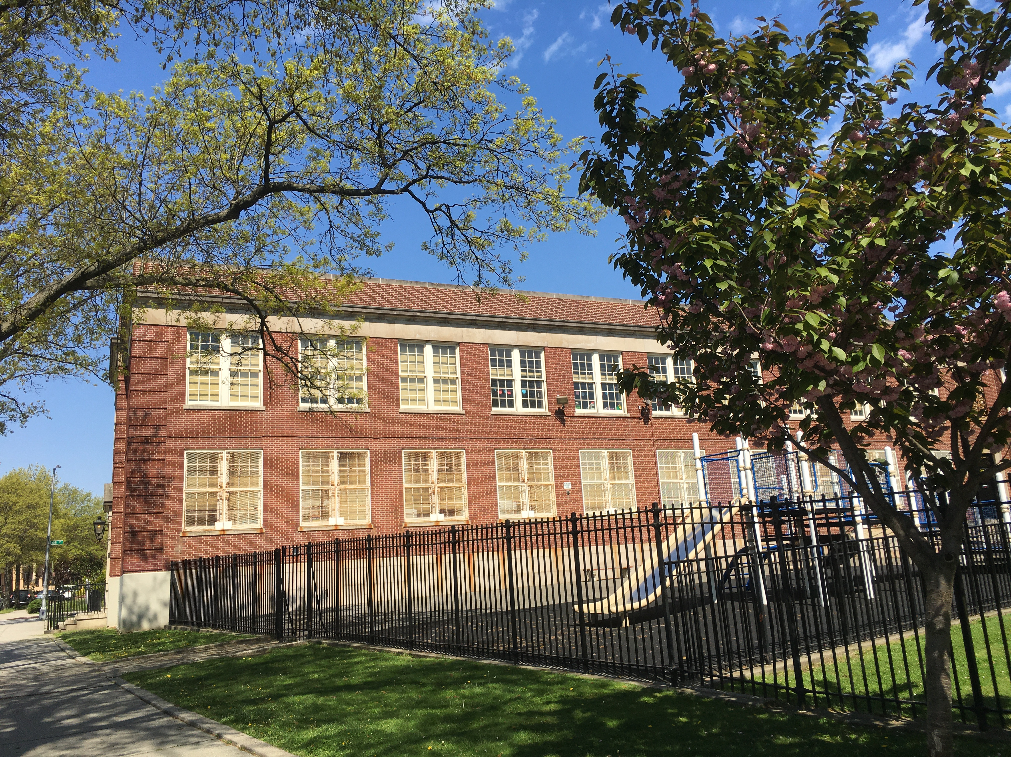
The Next Steps…
additional
“Updates on School Re-opening”
via email, Remind,
Town Hall and
Parent Information Sessions
Please complete the PS 174
Parent Survey, by August 14, 2020
Visit our websites---
ps174.org
schools.nyc.gov/ReturnToSchool

